Slide 1
CS 3006 Parallel and Distributed Computing Lecture 8
Danyal Farhat
FAST School of Computing
NUCES Lahore

Slide 2
Miscellaneous Topics

Slide 3
Outline
Motivating Parallelism
The Memory / Disk Speed Argument
The Data Communication Argument
Types of Parallelism
Data Parallelism
Functional Parallelism
Pipelining
Multi-Processor vs. Multi-Computer
Cluster vs. Network of Workstations

Slide 4
Outline (Cont.)
Cache Coherence
Snooping
Branch Prediction
Architecture of an Ideal Parallel Computer - PRAM
PRAM Classes
PRAM Arbitration Protocols
Physical Complexity of an Ideal Parallel Computer
Communication Costs in Parallel Machines

Slide 5
Outline (Cont.)
Message Passing Costs in Parallel Computers
Startup time, Per-hop time, Per-word transfer time
Store-and-Forward Routing, Packet Routing, Cut-Through Routing
Simplified Cost Model for Communicating Messages
Summary
Additional Resources

Slide 6
Motivating Parallelism
The Memory / Disk Speed Argument
While clock rates of high-end processors have increased at roughly 40% per year over the past decade, DRAM access times have only improved at the rate of roughly 10% per year over this interval
This mismatch in speeds causes significant performance bottlenecks
Parallel platforms provide increased bandwidth to the memory system

Slide 7
Motivating Parallelism (Cont.)
The Memory / Disk Speed Argument
Parallel platforms also provide higher aggregate caches
Some of the fastest growing applications of parallel computing utilize not their raw computational speed, rather their ability to pump data to memory and disk faster
CPU is fast but memory isn’t, which is a mismatch in context of parallel programming
Solution: Parallel platform (increased bandwidth to memory) and combination or collection of caches

Slide 8
Motivating Parallelism (Cont.)
The Data Communication Argument
As the network evolves, the vision of the Internet as one large computing platform has emerged.
In many applications like databases and data mining problems, the volume of data is such that they cannot be moved.
Any analyses on this data must be performed over the network using parallel techniques

Slide 9
Types of Parallelism
Data Parallelism
When there are independent tasks applying the same operation to different elements of a data set
Example code
for i=0 to 99 do
a[ i ] = b[ i ] + c [ i ]
Endfor
Here same operation addition is being performed on first 100 elements of ‘b’ and ‘c’ arrays
All 100 iterations of the loop could be executed simultaneously

Slide 10
Types of Parallelism (Cont.)
Functional Parallelism
When there are independent tasks applying different operations to different data elements
Example code
a=2
b=3
m= (a+b) / 2
s= (𝒂 x a + 𝒃 x b) / 2
v= s - 𝒎^𝟐
Here third and fourth statements could be performed concurrently

Slide 11
Types of Parallelism (Cont.)
Pipelining
Usually used for the problems where single instance of the problem can not be parallelized
The output of one stage is input of the other stage
Dividing whole computation of each instance into multiple stages provided that there are multiple instances of the problem

Slide 12
Types of Parallelism (Cont.)
Pipelining (Cont.)
An effective method of attaining parallelism on the uniprocessor architectures
Depends on pipelining abilities of the processor
Pentium 2 supports 12 stage pipelining
Pentium 4 supports 20 stage pipelining at 2.0 GHz

Slide 13
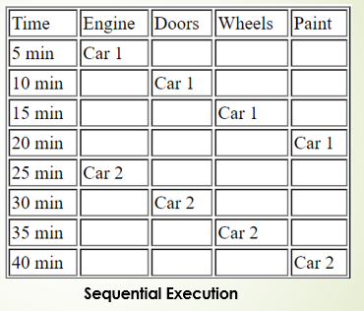
Types of Parallelism (Cont.)
Pipelining Example: Assembly line analogy

Slide 14
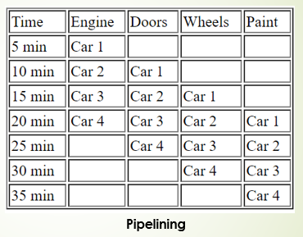
Types of Parallelism (Cont.)
Pipelining Example: Assembly line analogy

Slide 15
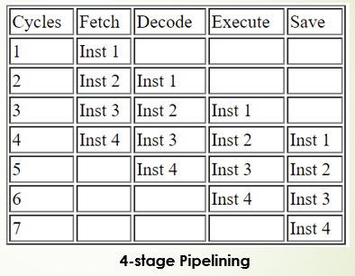
Types of Parallelism (Cont.)
Pipelining Example: Assembly line analogy

Slide 16
Multi-Processor vs. Multi-Computer
Multi-Processor
Multiple CPUs with a shared memory
Same address on two different CPUs refers to the same memory location
Generally two categories
Centralized Multi-processor
Distributed Multi-processor

Slide 17
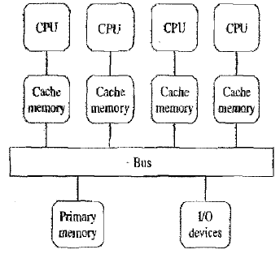
Multi-Processor vs. Multi-Computer (Cont.)
Centralized Multi-Processor
Additional CPUs are attached to the system bus, and all the processors share the same primary memory
All the memory is at one place and has the same access time from every processor
Also known to as UMA (Uniform Memory Access) Multi-processor or SMP (Symmetrical Multi-processor)

Slide 18
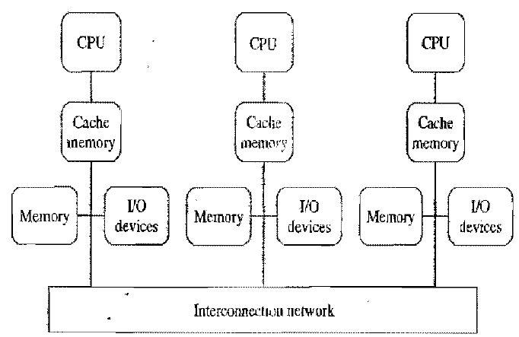
Multi-Processor vs. Multi-Computer (Cont.)
Distributed Multi-processor
Distributed collection of memories forms one logical address space
Again, the same address on different processors refers to the same memory location
Also known as Non-Uniform Memory Access (NUMA) architecture
Because, memory access time varies significantly, depending on the physical location of the referenced address

Slide 19
Multi-Processor vs. Multi-Computer (Cont.)
Multi-Computer
Distributed memory, multi-CPU computer
Unlike NUMA architecture, a multicomputer has disjoint local address spaces
Each processor has direct access to their local memory only
Same address on different processors refers to two different physical memory locations
Processors interact with each other through passing messages

Slide 20
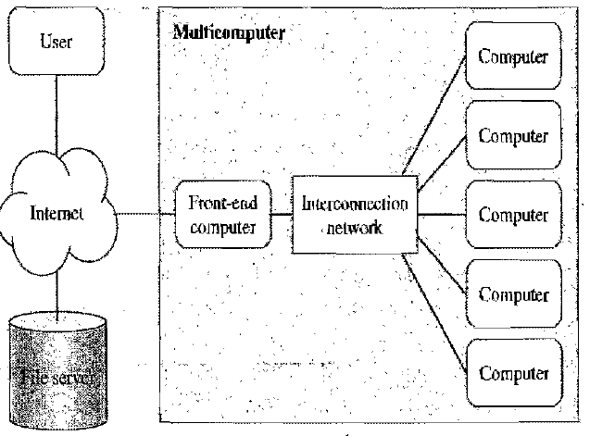
Multi-Processor vs. Multi-Computer (Cont.)
Asymmetric Multi-Computers
A front-end computer that interacts with users and I/O devices
The back-end processors are dedicatedly used for “number crunching”
Front-end computer executes a full, multi-programmed OS and provides all functions needed for program development
The backends are reserved for executing parallel programs

Slide 21
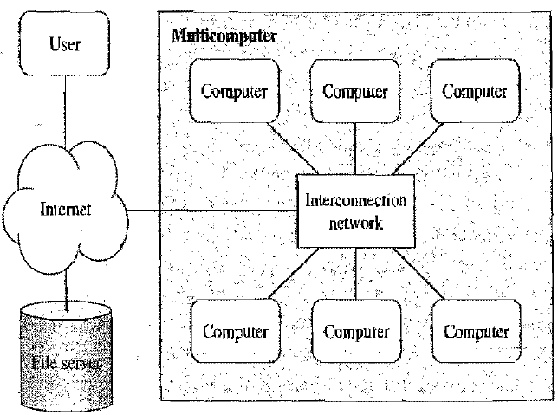
Multi-Processor vs. Multi-Computer (Cont.)
Symmetric Multi-Computers
Every computer executes same OS
Users may log into any of the computers
This enables multiple users to concurrently login, edit and compile their programs
All the nodes can participate in execution of a parallel program

Slide 22
Cluster vs. Network of Workstations
Cluster
Usually a co-located collection of low-cost computers and switches, dedicated to running parallel jobs
All computer run the same version of operating system
Some of the computers may not have interfaces for the users to login
Commodity cluster uses high speed networks for communication such as fast Ethernet at 100Mbps etc.
Network of workstations
A dispersed collection of computers
Individual workstations may have different Operating systems and executable programs
Users have the power to login and power off their workstations
Ethernet speed for this network is usually slower.
Typical in range of 10s Mbps

Slide 23
Cache Coherence
When we are in a distributed environment, each CPU’s cache needs to be consistent (continuously needs to be updated for current values), which is known as cache coherence

Slide 24
Snooping
Snoopy protocols achieve data consistency between the cache memory and the shared memory through a bus-based memory system
Write-invalidate and write-update policies are used for maintaining cache consistency

Slide 25
Branch Prediction
Branch prediction is a technique used in CPU design that attempts to guess the outcome of a conditional operation and prepare for the most likely result
Issues in pipelining of branch prediction:
If the prediction is true then the pipeline will not be flushed and no clock cycles will be lost
If the prediction is false then the pipeline is flushed and starts over with the current instruction

Slide 26
Physical Organization of Parallel Platforms
Architecture of an Ideal Parallel Computer
Parallel Random Access Machine (PRAM)
An extension to ideal sequential model: Random Access Machine (RAM)
PRAMs consist of p processors
A global memory
Unbounded size
Uniformly accessible to all processors with same address space
Processors share a common clock but may execute different instructions in each cycle
Based on simultaneous memory access mechanisms, PRAM can further be classified

Slide 27
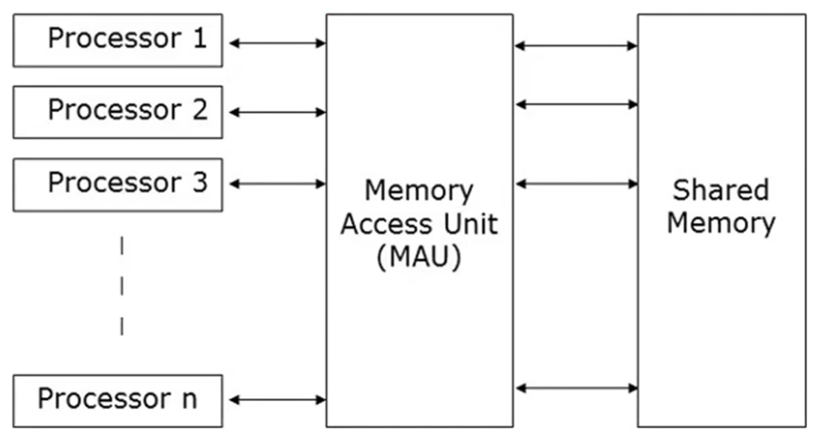
Graphical Representation of PRAM

Slide 28
Parallel Random Access Machine (PRAM)
PRAM has a set of similar type of processors
Processors communicate with each other using the shared memory
N processors can perform independent operations on N number of data in a given time, this might lead to simultaneous access of same memory location by different processors
To solve the simultaneous access of same memory location problem we have PRAM classes

Slide 29
PRAM Classes
PRAMs can be divided into four classes
Exclusive-Read, Exclusive-Write (EREW) PRAM
No two processors can perform read/write operations concurrently
Weakest PRAM model, provides minimum memory access concurrency
Concurrent-Read, Exclusive-Write (CREW) PRAM
All processors can read concurrently but can’t write at same time
Multiple write accesses to a memory location are serialized
Exclusive-Read, Concurrent-Write (ERCW) PRAM
No two processors can perform read operations concurrently, but can write
Concurrent-Read, Concurrent-Write (CRCW) PRAM
Most powerful PRAM model

Slide 30
PRAM Arbitration Protocols
Concurrent reads do not create any semantic inconsistencies
But, What about concurrent write?
Need of an arbitration (mediation) mechanism to resolve concurrent write access

Slide 31
PRAM Arbitration Protocols (Cont.)
Common
Write only if all values that processors are attempting to write are identical
Arbitrary
Write the data from a randomly selected processor and ignore the rest
Priority
Follow a predetermined priority order
Processor with highest priority succeeds and the rest fail
Sum
Write the sum of the data items in all the write requests
The sum-based write conflict resolution model can be extended for any of the associative operators, that is defined for data being written

Slide 32
Physical Complexity of an Ideal Parallel Computer
Processors and memories are connected via switches
Since these switches must operate in O(1) time at the level of words, for a system of p processors and m words, the switch complexity is O(mp)
Switches determine the memory word being accessed by each processor
Switch is a device that opens or closes access to certain data bank or word
Clearly, for meaningful values of p and m, a true PRAM is not realizable

Slide 33
Communication Costs in Parallel Machines
Along with idling (doing nothing) and contention (conflict e.g., resource allocation), communication is a major overhead in parallel programs
The communication cost is usually dependent on a number of features including the following:
Programming model for communication
Required pattern of the communication in the program
Network topology
Data handling and routing
Associated network protocols
Usually, distributed systems suffer from major communication overheads

Slide 34
Message Passing Costs in Parallel Computers
The total time to transfer a message over a network comprises of the following:
Startup time (t_{s}): Time spent at sending and receiving nodes (preparing the message [adding headers, trailers, and parity information] , executing the routing algorithm, establishing interface between node and router, etc.)

Slide 35
Message Passing Costs in Parallel Computers (Cont)
Per-hop time (t_{h}): This time is a function of number of hops (steps) and includes factors such as switch latencies, network delays, etc.
Also known as node latency
Also accounts for the latency to take decision of choosing next channel to which this message shall be forwarded
Per-word transfer time (t_{w}): This time includes all overheads that are determined by the length of the message. This includes bandwidh of links, and buffering overheads, etc.
If channel bandwidth is r words/s then each word take t_{w}= 1/r to traverse the link

Slide 36


Message Passing Costs in Parallel Computers (Cont)
Store-and-Forward Routing
A message traversing multiple hops is completely received at intermediate hop before being forwarded to next hop
The total communication cost for a message of size m words to traverse l communication links is
In most platforms, t_{h} is small and the above expression can be approximated by
Cost of header transfer at each hop (step) t_{h} t_{s} is startup time
mt_{w} is cost of transferring m words over the link

Slide 37

Message Passing Costs in Parallel Computers (Cont)
Packet Routing
Store-and-forward makes poor use of communication resources
Packet routing breaks messages into packets and pipelines them through the network
Since packets may take different paths, each packet must carry routing information, error checking, sequencing, and other related header information
Error checking (parity information), sequencing (order number)
Related headers: layers headers, addressing headers
The total communication time for packet routing is approximated by:
Here factor t_{w} also accounts for overheads in packet headers

Slide 38
Message Passing Costs in Parallel Computers (Cont)
Cut-Through Routing
Takes the concept of packet routing to an extreme by further dividing messages into basic units called flits or flow control digits
Since flits are typically small, the header information must be minimized
This is done by forcing all flits to take the same path, in sequence
A tracer message first programs all intermediate routers. All flits then take the same route

Slide 39
Message Passing Costs in Parallel Computers (Cont)
Cut-Through Routing (Cont.)
Error checks are performed on entire message, as opposed to flits
No sequence numbers are needed
Sequencing information is not needed as all the packets are following same path which ensures in-order delivery
The total communication time for cut-through routing is approximated by:
This is identical to packet routing, however, t_{w} is typically much smaller
Header of the message takes l* t_{h} to reach the destination and entire message arrives in time m t_{w} after the message header

Slide 40
Message Passing Costs in Parallel Computers (Cont.)
(a) through a store-and-forward communication network
b) and (c) extending the concept to cut-through routing
Shaded regions here represent the time where message is in transit (travel)
The startup time associated with this message transfer is assumed to be zero

Slide 41


Message Passing Costs in Parallel Computers (Cont)
Simplified Cost Model for Communicating Messages
The cost of communicating a message between two nodes l hops away using cut-through routing is given by:
In this expression, t_{h} is typically smaller than t_{s} and t_{w}. For this reason, the second term in the RHS does not show, particularly, when m is large
For these reasons, we can approximate the cost of message transfer by:
For communication using flits, start-up time dominates the node latencies

Slide 42
Message Passing Costs in Parallel Computers (Cont)
Simplified Cost Model for Communicating Messages (Cont.)
It is important to note that the original expression for communication time is valid for only uncongested networks
Different communication patterns congest different networks to varying extents
It is important to understand and account for this in the communication time accordingly

Slide 43
Summary
Motivating Parallelism
The Memory / Disk Speed Argument
Speed mismatch between processor and DRAM can be reduced using parallel platforms and aggregated caches
The Data Communication Argument
Analyses on large scale data can be performed over the network using parallel techniques

Slide 44
Summary (Cont.)
Types of Parallelism
Data Parallelism
Independent tasks applying the same operation to different elements of a data set
Functional Parallelism
Independent tasks applying different operations to different data elements
Pipelining
Effective method of attaining parallelism on the uniprocessor architectures

Slide 45
Summary (Cont.)
Multi-Processor vs. Multi-Computer
Multi-Processor - Multiple CPUs with a shared memory
Centralized Multi-Processor - All the memory is at one place and has Uniform Memory Access (UMA) architecture
Distributed Multi-processor - Distributed collection of memories forms one logical address space. Use Non-Uniform Memory Access (NUMA) architecture
Multi-Computer - Each processor has disjoint memory
Asymmetric Multi-Computers
A front-end computer interacts with users and I/O devices
The back-end processors are dedicated for processing
Symmetric Multi-Computers
Every computer executes same OS
This enables multiple users to concurrently login, edit and compile their programs

Slide 46
Summary (Cont.)
Cluster vs. Network of Workstations
Cluster - Co-located collection of computer with same version of OS
Network of Workstations - Dispersed collection of computers with different versions of OS
Cache Coherence
Cache continuously needs to be updated for current values
Snooping
Snoopy protocols achieve data consistency between cache and memory through a bus based memory system

Slide 47
Summary (Cont.)
Branch Prediction
Used in CPU design to guess the outcome of a conditional operation and prepare for the most likely result
Architecture of an Ideal Parallel Computer – PRAM
Extension to ideal sequential model: Random Access Machine (RAM)
Consist of p processors
Global memory (Unbounded size, Uniformly accessible to all processors with same address space)

Slide 48
Summary (Cont.)
PRAM Classes
Exclusive-Read, Exclusive-Write (EREW) PRAM
Concurrent-Read, Exclusive-Write (CREW) PRAM
Exclusive-Read, Concurrent-Write (ERCW) PRAM
Concurrent-Read, Concurrent-Write (CRCW) PRAM
PRAM Arbitration Protocols
Concurrent writes do create semantic inconsistencies
We need an arbitration mechanism to resolve concurrent write access
Common, Arbitrary, Priority, Sum protocols can be used

Slide 49
Summary (Cont.)
Physical Complexity of an Ideal Parallel Computer
Processors and memories are connected via switches
Switches must operate in O(1) time at the level of words, for a system of p processors and m words, the switch complexity is O(mp)
For meaningful values of p and m, a true PRAM is not realizable

Slide 50
Summary (Cont.)
Communication Costs in Parallel Machines
Message Passing Costs in Parallel Computers
Startup time, Per-hop time, Per-word transfer time
Store-and-Forward Routing
Packet Routing
Cut-Through Routing
Simplified Cost Model for Communicating Messages

Slide 51
Additional Resources
Book: Introduction to Parallel Computing by Ananth Grama and Anshul Gupta
Chapter 1: Introduction to Parallel Computing
1.1 Motivating Parallelism
Flynn, M., “Some Computer Organizations and Their Effectiveness,” IEEE Transactions on Computers, Vol. C-21, No. 9, September 1972.
Kumar, V., Grama, A., Gupta, A., & Karypis, G. (1994). Introduction to parallel computing (Vol. 110). Redwood City, CA: Benjamin/Cummings.

Slide 52
Questions?

